Slide 1

Austin SIGKDD Spark talk
Random Forest and Decision Trees in Spark MLlib
Tuhin Mahmud
Sep 20th, 2017

Slide 2
About Me
Tuhin Mahmud
Advisory Software Engineer , IBM
tuhinm@hotmail.com
https://www.linkedin.com/in/tuhinmahmud/

Slide 3
Agenda
Spark and MLLib Overview
Decision Trees in Spark MlLib
Random Forest in Spark MlLib
Demo

Slide 4

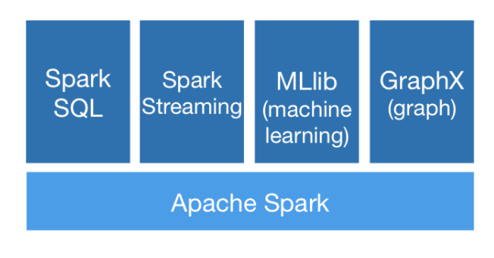
What is MLlib?
MLlib is Spark’s machine learning (ML) library.
Its goal is to make practical machine learning scalable and easy to use.
ML algorithms include Classification , Regression , Decision Trees and random Forests, Recommendation, Clustering,Topic Modeling (LDA), Distributed linear Algebra(SVD,PCA) and many more.
https://spark.apache.org/docs/latest/ml-guide.html

Slide 5
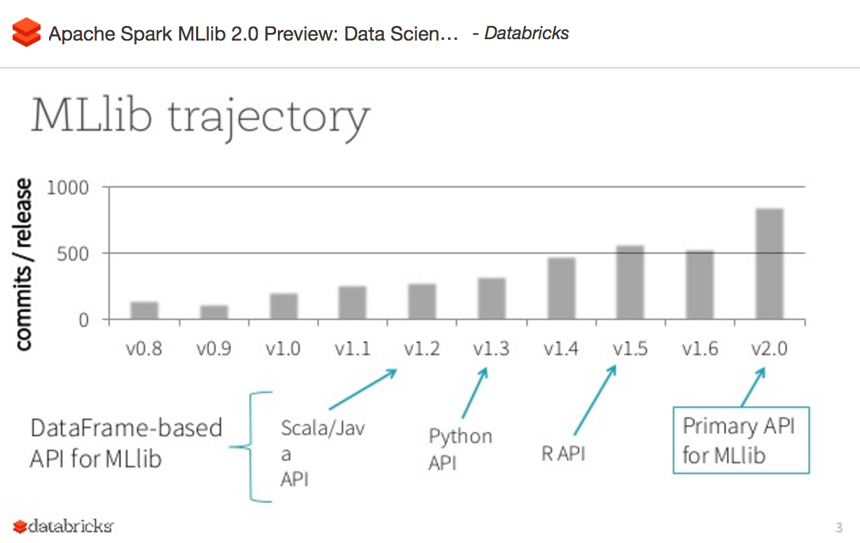
Spark MLlib Trajectory
https://www.slideshare.net/databricks/apache-spark-mllib-20-preview-data-science-and-production

Slide 6
Spark MlLib
Initially developed by MLbase team in AmpLab (UC berkeley) - supported only Scala and Java
Shipped to spark v0.8 ( Sep 2013)
Current release Spark 2.2.0 released (Jul 11, 2017)
MLLib 2.2:
DataFrame-based Api becomes the primary API for MLlib
org.apache.spark.ml and pysprak.ml
Ease of use
Java, Scala, Python, R
interoperates with NumPy in Python
Any Hadoop data source (e.g. HDFS, HBase, or local files), making it easy to plug into Hadoop workflows.

Slide 7
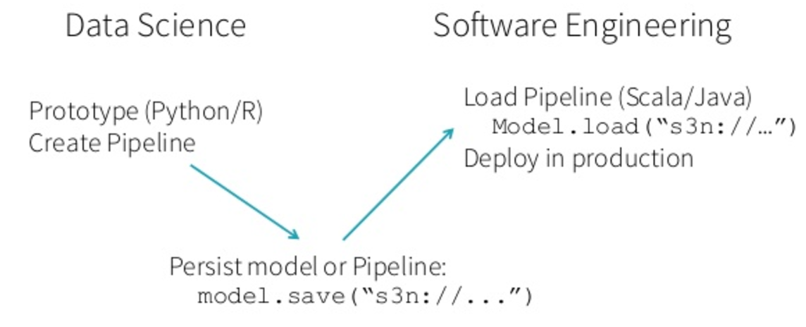
Spark Mllib in production
ML persistence
Saving and loading
Pipeline MLlib standardizes APIs for machine learning algorithms to make it easier to combine multiple algorithms into a single pipeline, or workflow. This section covers the key concepts introduced by the Pipelines API, where the pipeline concept is mostly inspired by the scikit-learn project.
Some concepts[5]
DataFrame
Transformer - one dataframe to another
Estimator - fits on a dataframe to produce a transformer
Pipeline A pipeline chains multiple transformers and Estimators to specify ML workflow.
Parameter

Slide 8
MLlib 2.2.0 API
MLlib: RDD-based API ( maintanace mode)
MLlib: DataFrame-based API
Why is MLlib switching to the DataFrame-based API?
DataFrames provide a more user-friendly API than RDDs.
The many benefits of DataFrames include Spark Datasources,
SQL/DataFrame queries, Tungsten and Catalyst optimizations,
uniform APIs across languages.
The DataFrame-based API for MLlib provides a uniform API across ML algorithms and across multiple languages.
DataFrames facilitate practical ML Pipelines, particularly feature transformations. See the Pipelines guide for details.
What is “Spark ML”?
“Spark ML” is not an official name but occasionally used to refer to the MLlib DataFrame-based API.
https://spark.apache.org/docs/2.2.0/ml-guide.html

Slide 9
Agenda
Spark and MLLib Overview
Decision Tree in Spark MlLib
Random Forest in Spark MlLib
Demo

Slide 10
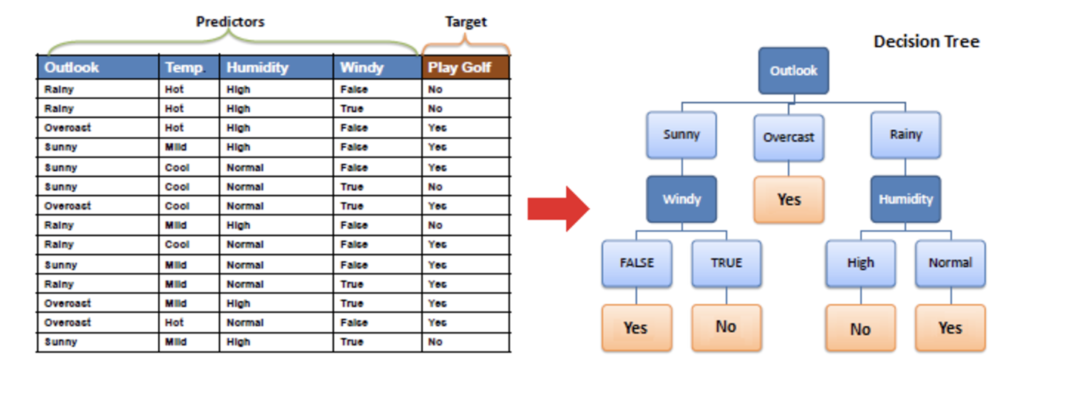
Decision Tree
http://www.saedsayad.com/decision_tree.htm

Slide 11
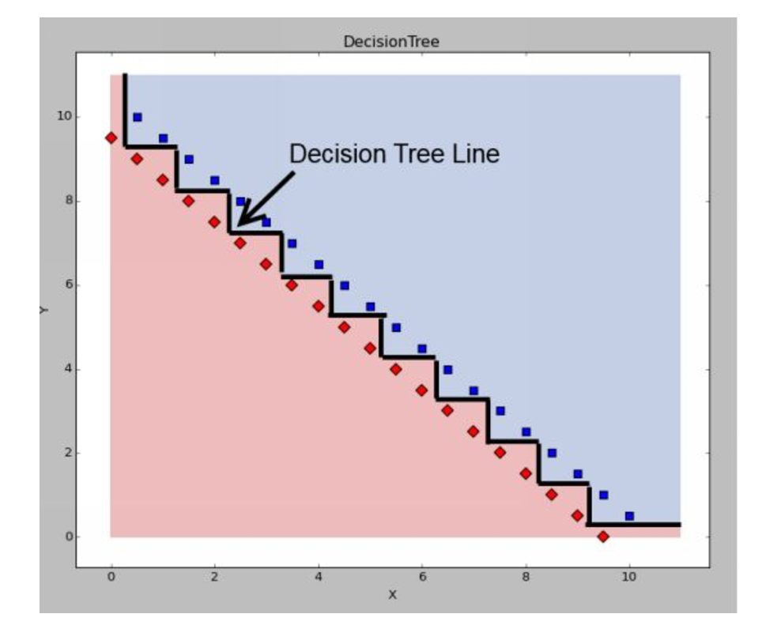
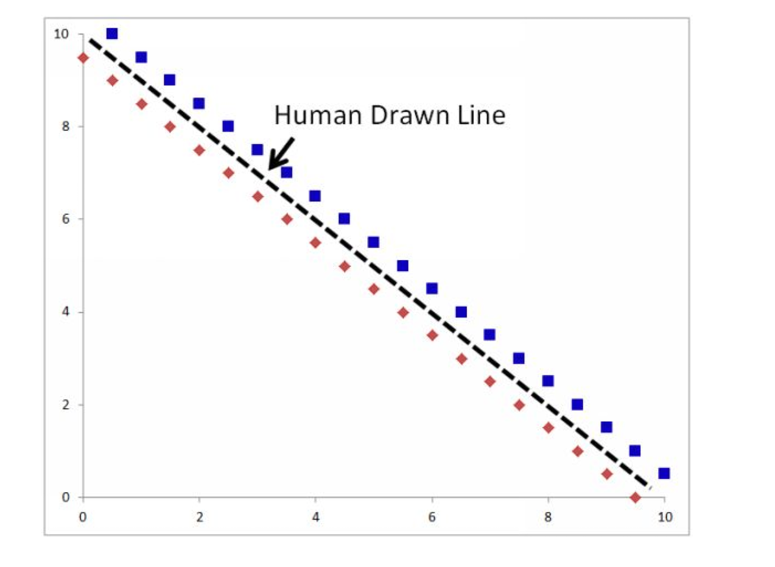
Decision Tree Applied
Machine learning with Random Forests And Decision Trees- A visual Guide for Beginner - by Scott Hartshorn

Slide 12
DecisionTrees packages in MLlib
from pyspark.mllib.tree import DecisionTree, DecisionTreeModel ( RDD based)
from pyspark.ml.classification import DecisionTreeClassifier (Dataframe based)
https://spark.apache.org/docs/2.2.0/ml-classification-regression.html#decision-trees

Slide 13
DecisionTree Classifier (MLlib Dataframe based API)
>>> from pyspark.ml.linalg import Vectors >>> from pyspark.ml.feature import StringIndexer >>> df = spark.createDataFrame([ ... (1.0, Vectors.dense(1.0)), ... (0.0, Vectors.sparse(1, [], []))], ["label", "features"]) >>> stringIndexer = StringIndexer(inputCol="label", outputCol="indexed") >>> si_model = stringIndexer.fit(df) >>> td = si_model.transform(df) >>> dt = DecisionTreeClassifier(maxDepth=2, labelCol="indexed") >>> model = dt.fit(td) >>> model.numNodes
https://spark.apache.org/docs/2.2.0/api/python/pyspark.ml.html#pyspark.ml.classification.DecisionTreeClassifier

Slide 14
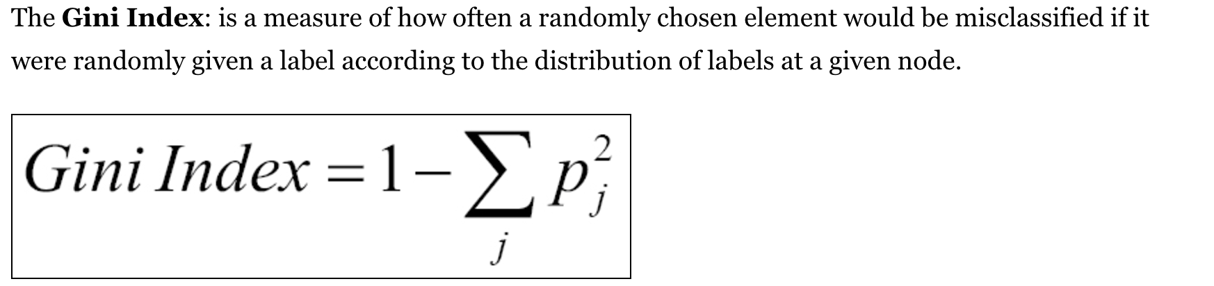
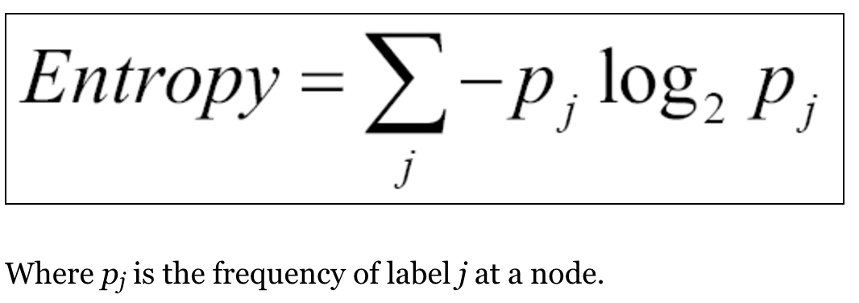
Decison Tree
hyper-parameters for decision tree in MlLib
numClasses: How many classes are we trying to classify?
categoricalFeaturesInfo: A specification whereby we declare what features are categorical features and should not be treated as numbers
impurity: A measure of the homogeneity of the labels at the node. Currently in Spark, there are two measures of impurity with respect to classification: Gini and Entropy
maxDepth: A stopping criterion which limits the depth of constructed trees. Generally, deeper trees lead to more accurate results but run the risk of overfitting.
maxBins: Generally, increasing the number of bins allows the tree to consider more values but also increases computation time.

Slide 15
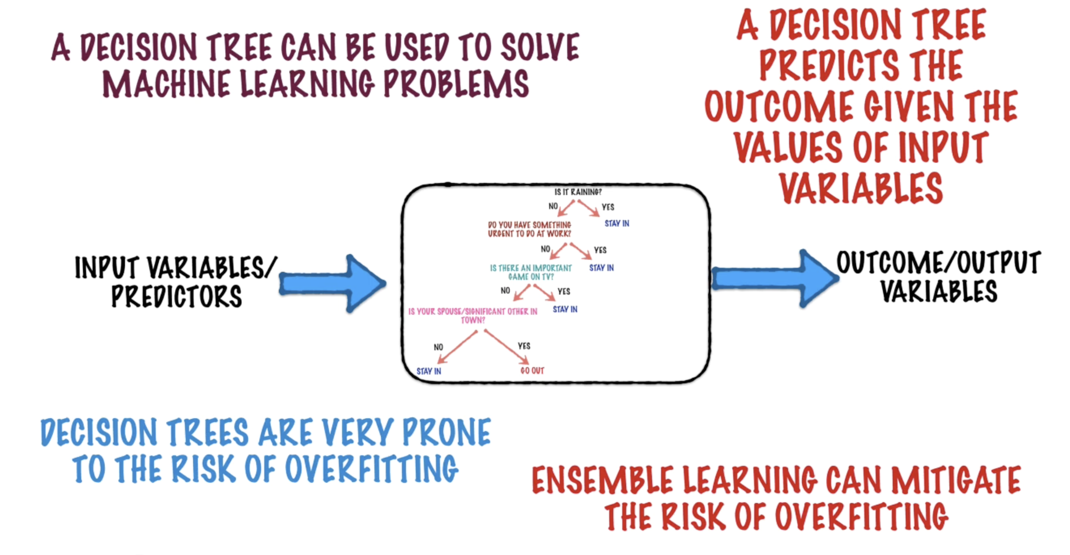
Decision Trees are prone to Overfitting
Reference: Machine Learning - Decision Trees and Random Forests - by Loonycorn

Slide 16

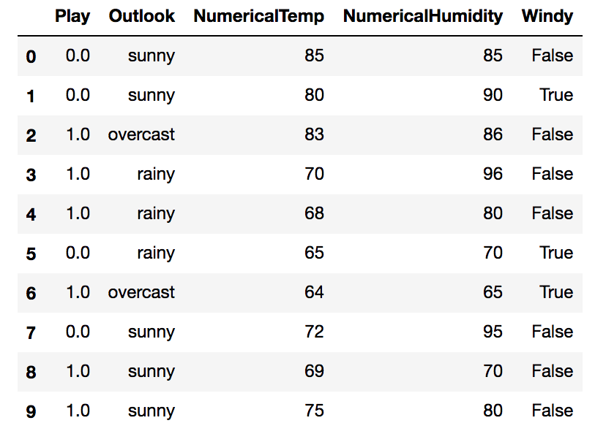
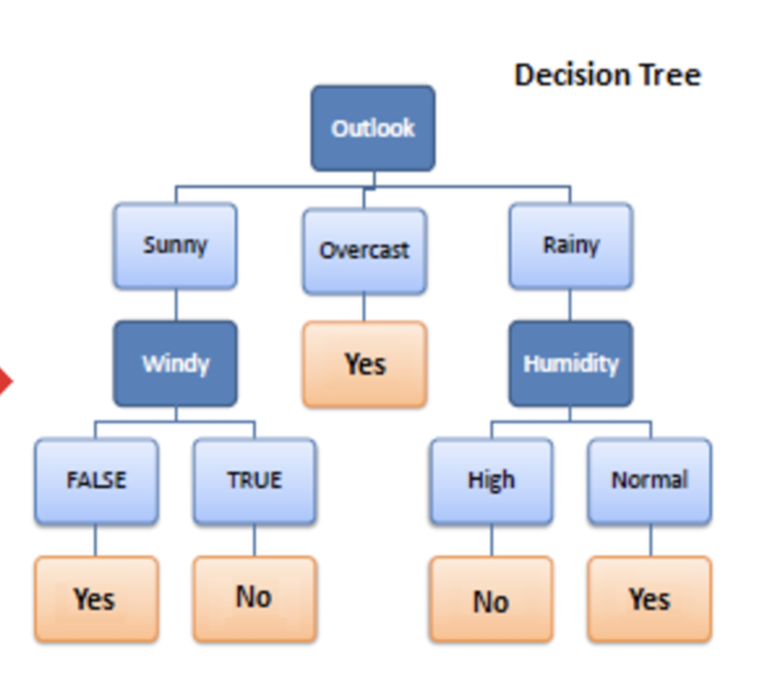
Spark MLlib -Decision Tree Example Notebook
Notebook using small dataset golf play http://nbviewer.jupyter.org/github/tuhinmahmud/sigkdd_austin/blob/master/SparkMllibPyspark.golf.ipynb
image:http://i2.cdn.turner.com/dr/pga/sites/default/files/articles/bro-hof-17th-bubba-072411-640x360.jpg?1311698162

Slide 17
Agenda
Spark and MLLib Overview
Decision Tree in Spark MlLib
Random Forest in Spark MlLib
Demo

Slide 18
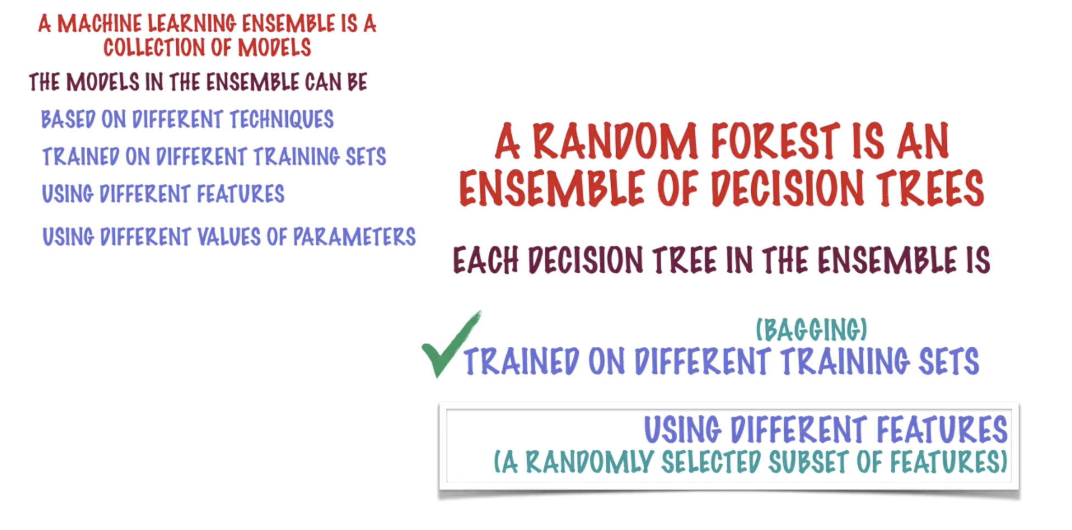
Random Forest as Ensemble
Reference: Machine Learning - Decision Trees and Random Forests - by Loonycorn

Slide 19
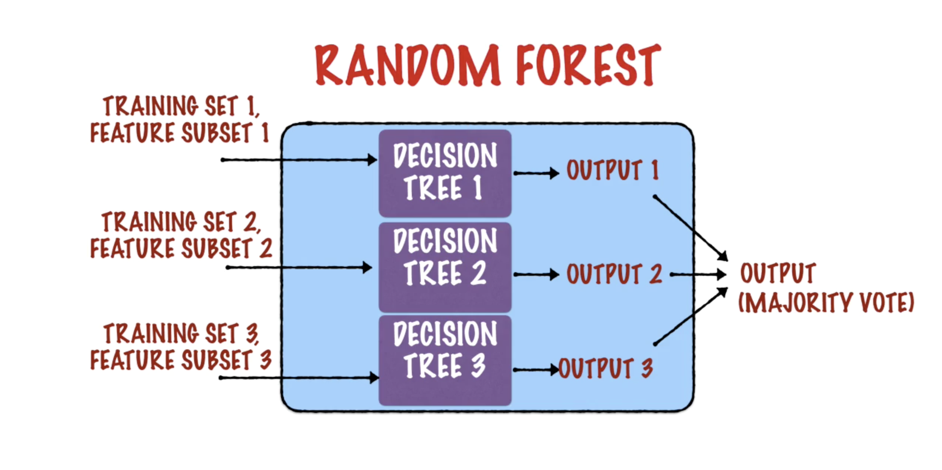
Reference: Machine Learning - Decision Trees and Random Forests - by Loonycorn

Slide 20
Random Forest
The name “Random Forest” comes from combining the randomness that is used to pick the subset of data with having a bunch of Decision trees.
A random forest (RF) is a collection of tree predictors
f ( x, T, Θk ), k = 1,…,K
where the Θk are i.i.d random vectors.
The trees are combined by
voting (for classification)
averaging (for regression).

Slide 21
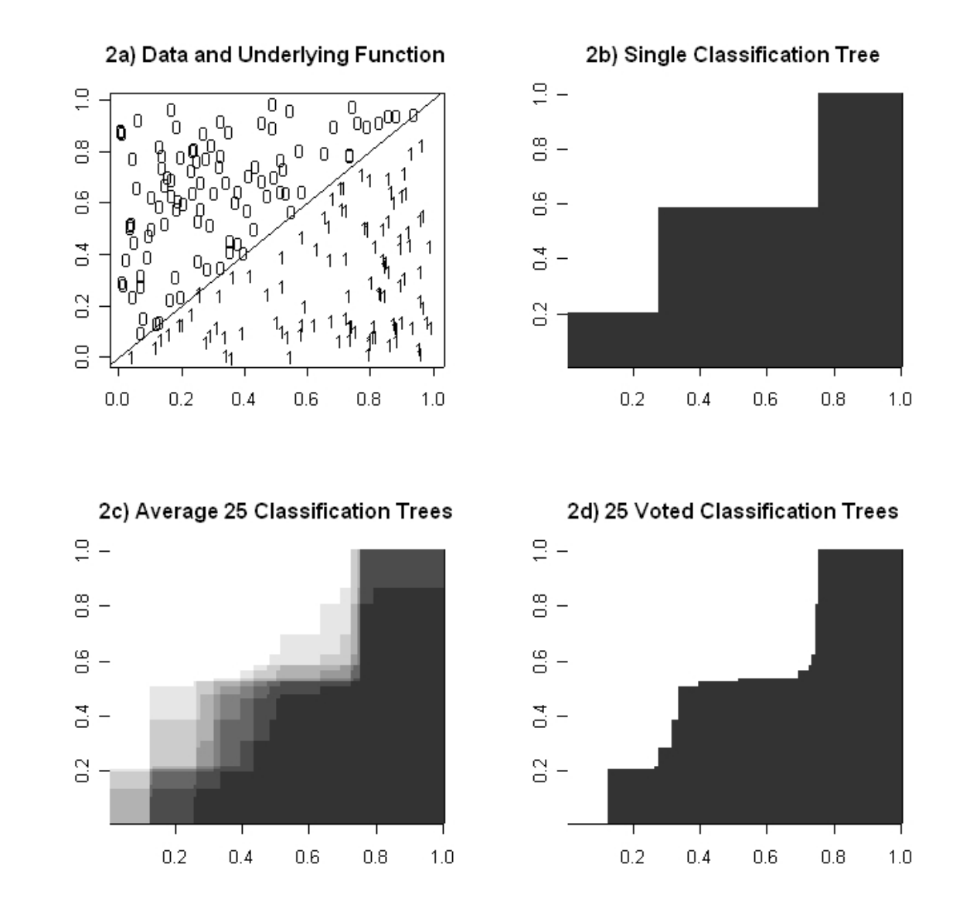
Random Forest
http://www.math.usu.edu/adele/RandomForests/ENAR.pdf

Slide 22
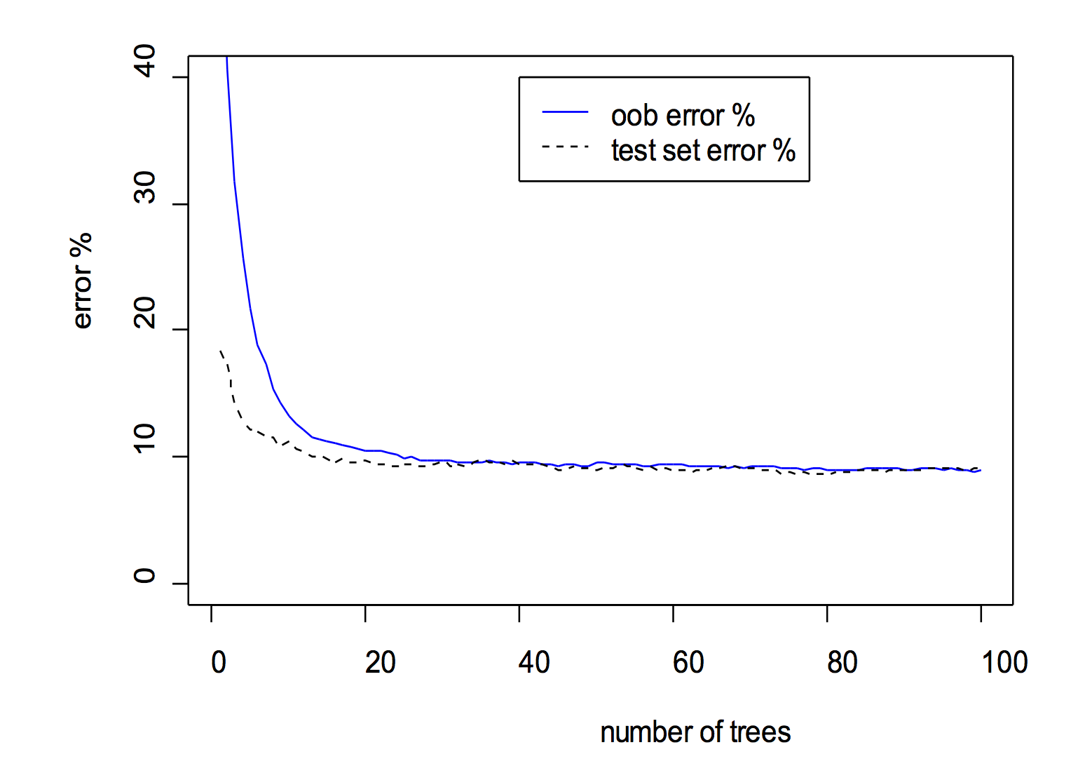
Random Forest - Out of bag Error
Out-of-bag Error Estimate
Average over the cases within each class to get a classwise out-of-bag error rate.
Average over all cases to get an overall out-of-bag error rate.
In random forests, there is no need for cross-validation to get an unbiased estimate of the test set error. It is estimated internally,

Slide 23
RandomForest in MLLib
DataFrame Based API
class pyspark.ml.classification.RandomForestClassifier(self, featuresCol="features", labelCol="label", predictionCol="prediction", probabilityCol="probability", rawPredictionCol="rawPrediction", maxDepth=5, maxBins=32, minInstancesPerNode=1, minInfoGain=0.0, maxMemoryInMB=256, cacheNodeIds=False, checkpointInterval=10, impurity="gini", numTrees=20, featureSubsetStrategy="auto", seed=None, subsamplingRate=1.0)[source]¶
>>> import numpy>>> from numpy import allclose >>> from pyspark.ml.linalg import Vectors >>> from pyspark.ml.feature import StringIndexer >>> df = spark.createDataFrame([ ... (1.0, Vectors.dense(1.0)), ... (0.0, Vectors.sparse(1, [], []))], ["label", "features"]) >>> stringIndexer = StringIndexer(inputCol="label", outputCol="indexed") >>> si_model = stringIndexer.fit(df) >>> td = si_model.transform(df) >>> rf = RandomForestClassifier(numTrees=3, maxDepth=2, labelCol="indexed", seed=42) >>> model = rf.fit(td)
https://spark.apache.org/docs/2.2.0/ml-classification-regression.html#random-forest-classifier

Slide 24
Random Forest - parameters
RandomForest - some parameters ( older RDD based but some apply to dataframe based)
numTrees: Number of trees in the resulting forest. Increasing the number of trees decreases model variance.
featureSubsetStrategy: Specifies a method which produces a number of how many features are selected for training a single tree.
seed: Seed for random generator initialization, since RandomForest depends on random selection of features and rows
The parameters numTrees and maxDepth are often referenced as stopping criteria.

Slide 25
Random Forest -parameters
Spark also provides additional parameters to stop tree growing and produce fine-grained trees:
minInstancesPerNode: A node is not split anymore, if it would provide left or right nodes which would contain smaller number of observations than the value specified by this parameter. Default value is 1, but typically for regression problems or large trees, the value should be higher.
minInfoGain: Minimum information gain a split must get. Default value is 0.0.

Slide 26
MLlib - Labeled point vector (RDD based)
Labeled point vector
Prior to running any supervised machine learning algorithm using Spark MLlib, we must convert our dataset into a labeled point vector.
val higgs = response.zip(features).map { case (response, features) => LabeledPoint(response, features) } higgs.setName("higgs").cache()
An example of a labeled point vector follows:
(1.0, [0.123, 0.456, 0.567, 0.678, ..., 0.789])

Slide 27
MLlib - data caching
Data caching
Many machine learning algorithms are iterative in nature and thus require multiple passes over the data.
Spark provides a way to persist the data in case we need to iterate over it. Spark also publishes several StorageLevels to allow storing data with various options:
NONE: No caching at all
MEMORY_ONLY: Caches RDD data only in memory
DISK_ONLY: Write cached RDD data to a disk and releases from memory
MEMORY_AND_DISK: Caches RDD in memory, if it's not possible to offload data to a disk
OFF_HEAP: Use external memory storage which is not part of JVM heap

Slide 28

Making sense of a tragedy - titanic dataset
Notebook using titanic dataset and MLlib spark dataframe based apis for Decision Tree and Random Forest http://nbviewer.jupyter.org/github/tuhinmahmud/sigkdd_austin/blob/master/SparkMlLibTitanicNewDFbasedAPI.ipynb
image:http://www.oceangate.com/images/expeditions/titanic/titanic-sinking-wikimedia-commons.jpg

Slide 29
Notebooks
Notebook using small dataset golf play http://nbviewer.jupyter.org/github/tuhinmahmud/sigkdd_austin/blob/master/SparkMllibPyspark.golf.ipynb
Notebook using titanic dataset and MLlib spark dataframe based apis for Decision Tree and Random Forest http://nbviewer.jupyter.org/github/tuhinmahmud/sigkdd_austin/blob/master/SparkMlLibTitanicNewDFbasedAPI.ipynb

Slide 30
THANK YOU!

Slide 31
Back slide : Spark Stack

Slide 32
Reference
https://www.slideshare.net/databricks/apache-spark-mllib-20-preview-data-science-and-production
https://spark.apache.org/mllib/
https://spark.apache.org/docs/latest/ml-guide.html
http://www.saedsayad.com/decision_tree.htm
http://www.math.usu.edu/adele/RandomForests/ENAR.pdf
https://spark.apache.org/docs
https://spark.apache.org/docs/2.2.0/ml-classification-regression.html#random-forest-classifier
https://spark.apache.org/docs/2.2.0/api/python/pyspark.ml.html#pyspark.ml.classification.DecisionTreeClassifier
Books: Machine learning with Random Forests And Decision Trees- A visual Guide for Beginner - by Scott Hartshorn
Machine Learning - Decision Trees and Random Forests - by by Loonycorn

